Slide 1
GoFrugal
Task Assessment - Evaluation -1
by,
SIDHARTH S

Slide 2
Problem statement
Collect tweets associated wrt leading Indian online Retailers covering the period from 2019-2021.
Your goal is to do data scraping and preprocessing for the tweets and build a sentiment analysis or text classification or topic modelling pipeline.
Derive insights on how well the leading online retail brands are performing and how their products and services are perceived by their customers.

Slide 3
Architecture Diagram
Web Scraping (from Twitter)
Sentiment Analysis
Flask Deployment
Train data
NLP
app.py file
Test data
Random forest model

Slide 4
Collecting Tweets
Using snscrape package, I extracted tweets of leading Indian online retailers covering the period from 2019-2021.
such as Amazon, Flipkart, Myntra, Ajio, Snapdeal.
I collected 10,000 tweets and stored it in twitter_data.csv file.
Similarly I extracted tweets for test data and stored it in test.csv file.

Slide 5
Data Preprocessing & Sentiment analysis
Cleaning the tweets :
Removing punctuations, links,...
Removing Emojis
Finding Subjectivity and Polarity using TextBlob package:
Subjectivity : tells whether statement is a Fact or Opinion.
Polarity :tells whether statement is Positive or Negative.

Slide 6
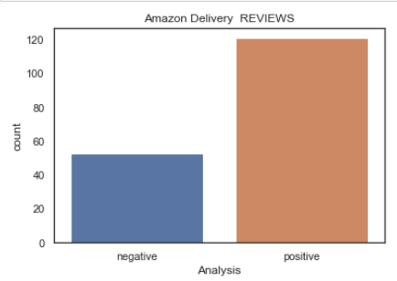
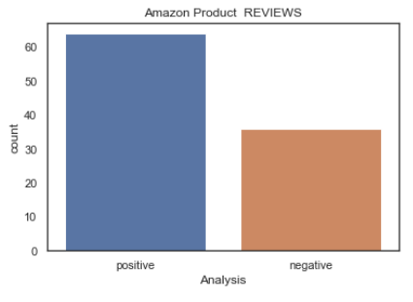
Deriving Insights from the Data
Positive reviews > Negative reviews
Hence, Amazon’s Delivery is good
Positive reviews > Negative reviews
Hence, Amazon’s are good

Slide 7
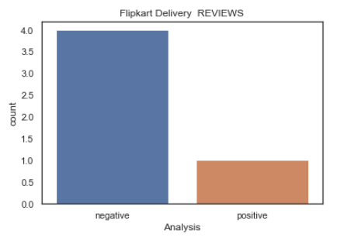
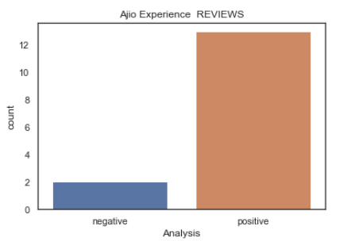
Deriving Insights from the Data
Positive comments << Negative comments.
Hence, Flipkart’s Delivery is poor
Needs improvements
Positive reviews >> Negative reviews.
Hence, Ajio’s overall customer experience is good

Slide 8
Modelling
Creating a Target Variable:
Binary classification (positive / negative comments)
Transforming the tweets using TFIDF vectorizer
Modelling using Random Forest algorithm
Got an accuracy of 87%
Aucroc of 82%

Slide 9
Deploying the Model using FLASK
Saving the model using Pickle package:
'Sentiment_analysis.pkl' – for model prediction.
'Transformer.pkl' – for vectorization of tweet.
‘Test.csv’ – is the test file. (for testing the app)
Creating ‘app.py’ file:
Loading the pickle files.
Uploading the test file.
Creating webpages using HTML files:
Home page – (input page)
Result page – (prediction is done here)
Running the app

Slide 10
THANK YOU

